Slide 1
Welcome to MSDS 6371 Statistical Foundations Live Session 11, January 19, 2021
Announcements
Instructor: Dr. Martin Selzer
Office Hours (Schedule Appointment by Email)
Teaching Assistant is Michael Wang
My email martin.selzer@gmail.com and mselzer@mail.smu.edu

Slide 2
Agenda Session 11
Breakout – Live Session Questions 25 Mins 35
Review Live Session Answers 55 Mins 80
Summary, Questions 10 Mins 90

Slide 3
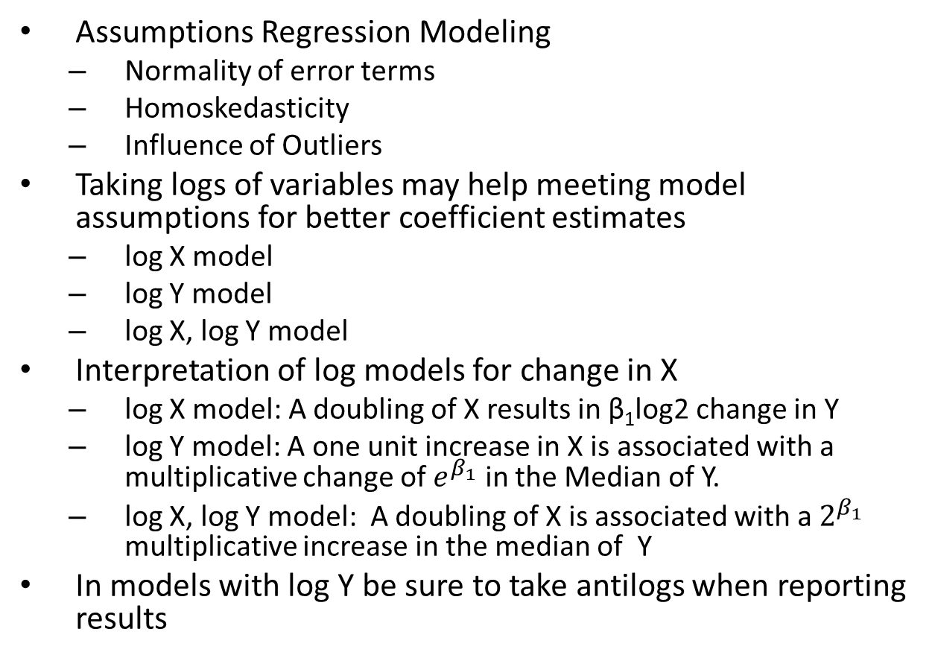
Summary
Assumptions Regression Modeling
Normality of error terms
Homoskedasticity
Influence of Outliers
Taking logs of variables may help meeting model assumptions for better coefficient estimates
log X model
log Y model
log X, log Y model
Interpretation of log models for change in X
log X model: A doubling of X results in β₁log2 change in Y
log Y model: A one unit increase in X is associated with a multiplicative change of $e^{β_{1}}$ in the Median of Y.
log X, log Y model: A doubling of X is associated with a $2^{β_{1}}$ multiplicative increase in the median of Y
In models with log Y be sure to take antilogs when reporting results

